Slide 1


DataFest Hackathon
Andy Freeman
Project Engineer Digital Transformation Solution Centre Manager

Slide 2





LEVEL
3
LEVEL
4
We expect responsible behaviour & we will challenge anything less
From side door emergency exit turn left
LEVEL
1
OGTC
Entrance
LEVEL
2
Fire Emergency Evacuation of Building
In the event of hearing the fire alarm please proceed immediately to the nearest available safest fire exit.
Do not use the lift.
There are two exits on the ground floor: the front door and the side door - which is to the right coming down the stairs to level 1.
From either exit, exit left onto Queens Road and continue down to No: 14. Queens Road. Assembly point is the rear car park of number 14 Queens Road, accessed via the side pathway.
Please assemble in the rear car park and wait for instructions from the Fire Wardens.
LEVEL
0
Fire Escape Routes

Slide 3


An introduction to hackathons and how to get started in Python and data science
13th March 2019
James Smith
CTO
www.projectingsuccess.co.uk
https://tinyurl.com/y59z4koy
Page 3 | 12/03/2019 | | www.projectingsuccess.co.uk

Slide 4
Overview
Introduction
9:30 – Introduction to a Hackathon
Mini Hackathon
10:00 - Exercise - How to tackle data analytics problems. Group work (part_1)
10:30 - Python masterclass class - An introduction to web scraping
11:00 – Challenge 1 Group work (part_2)
12:00 – Team presentations
12:30 – Lunch
13:30 – Challenge 2. Group work (part_1)
14:00 - Python masterclass/exercise class - An introduction to machine learning
14:30 – Group work (part_2)
15:30 – Team presentations
16:00 – Finish/Feedback

Slide 5
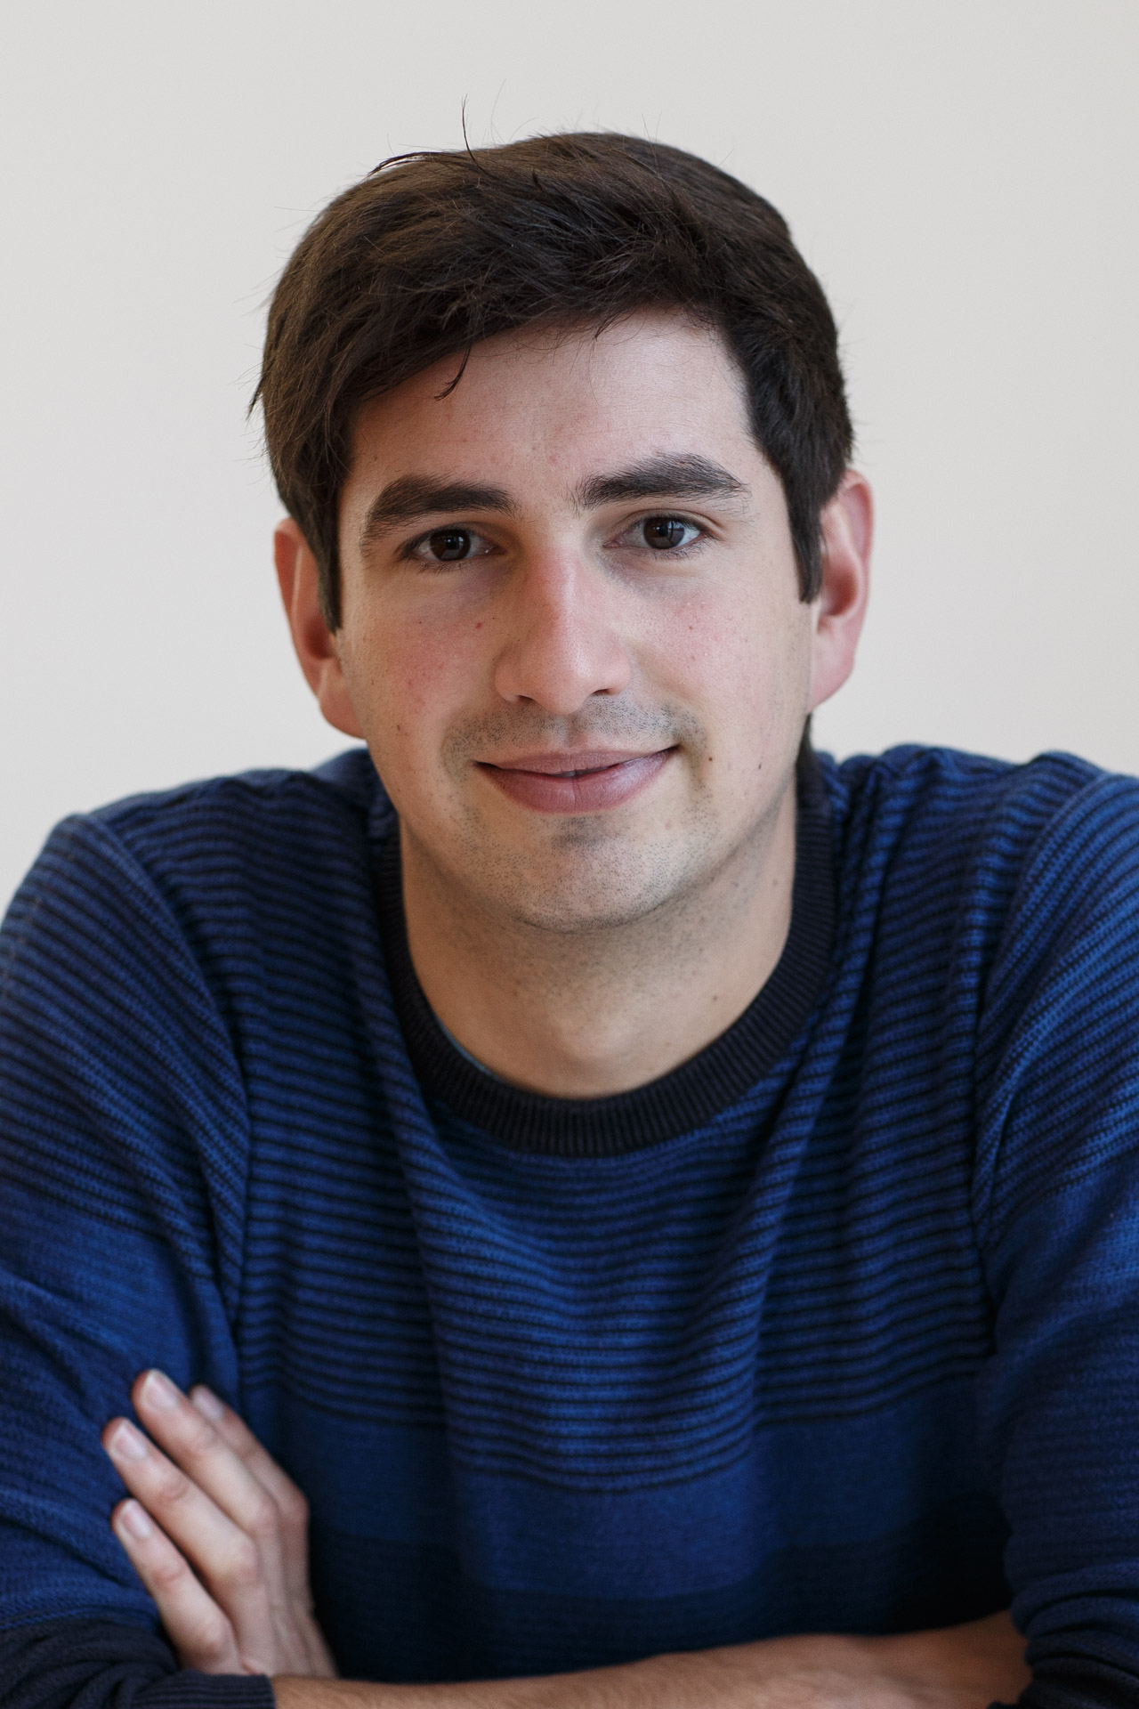
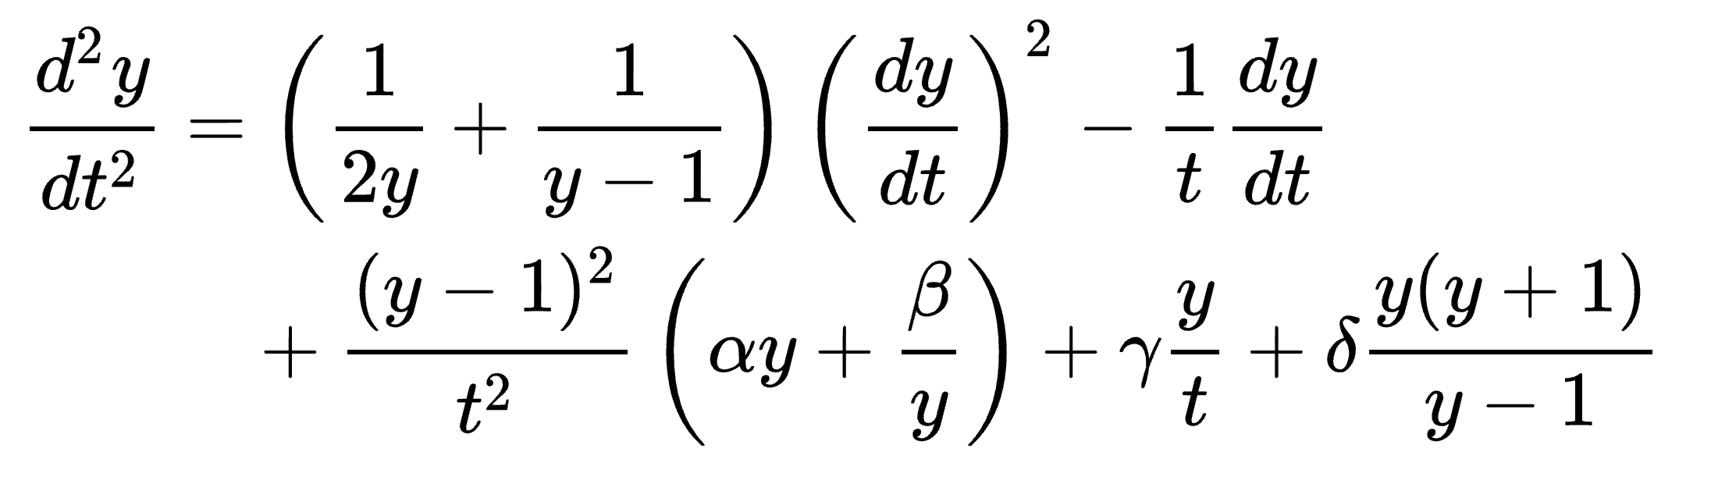


Who am I?
Completed my PhD in applied Mathematics in 2015 – Painlevé equations and Orthogonal Polynomials
Lectured mathematics at the University of Kent
Joined Projecting Success in 2017
Interests:
Mathematics
Machine Learning
Python

Slide 6
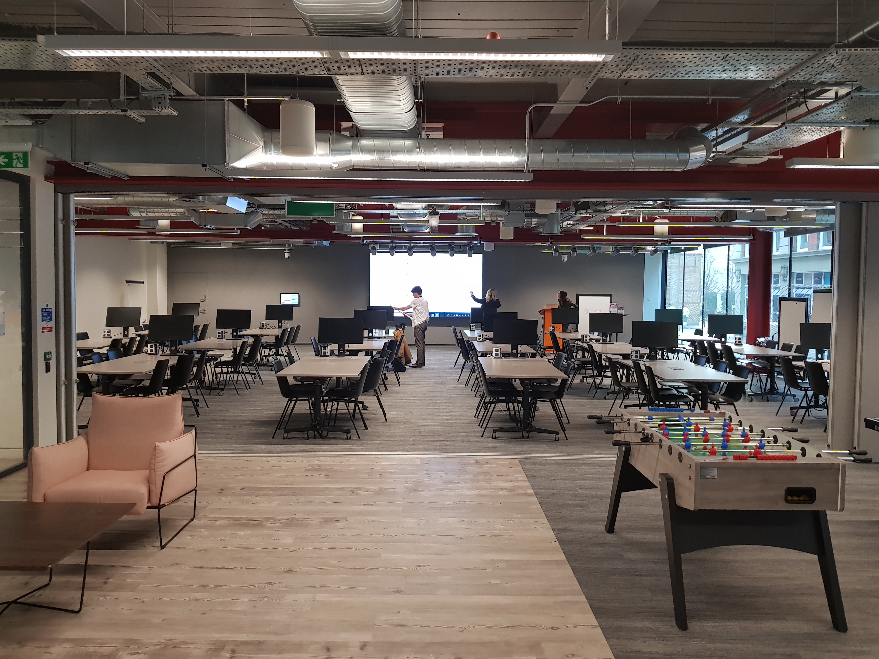
What is a Hackathon?
An event, typically lasting several days, in which a large number of people meet to engage in collaborative data analytics.
The delegates have a diverse range of skills.
Intensive problem solving

Slide 7
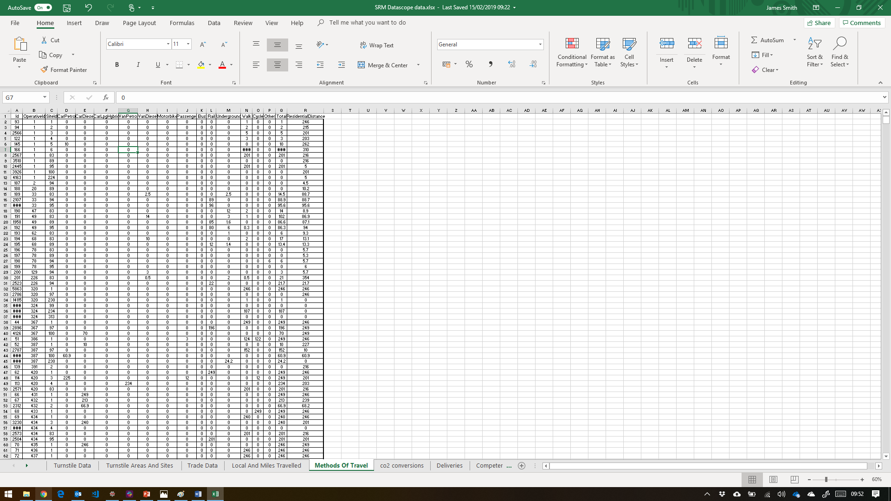
Behind the scenes
Data anonymisation.
Data cleansing.
Creation of challenges.
Validation of challenges.
Event planning
13 Challenges
101 Attendees
120 Bacon sandwiches eaten
1212 Hours worked
5 Masterclasses
1.62GB Datasets crunched
3 Million rows if data analysed
15 Business driven solutions proposed
£1000 Prizes given

Slide 8
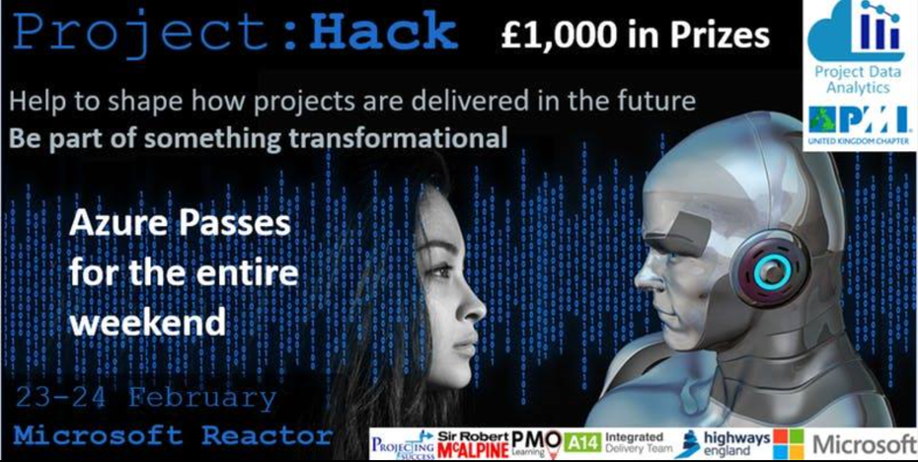

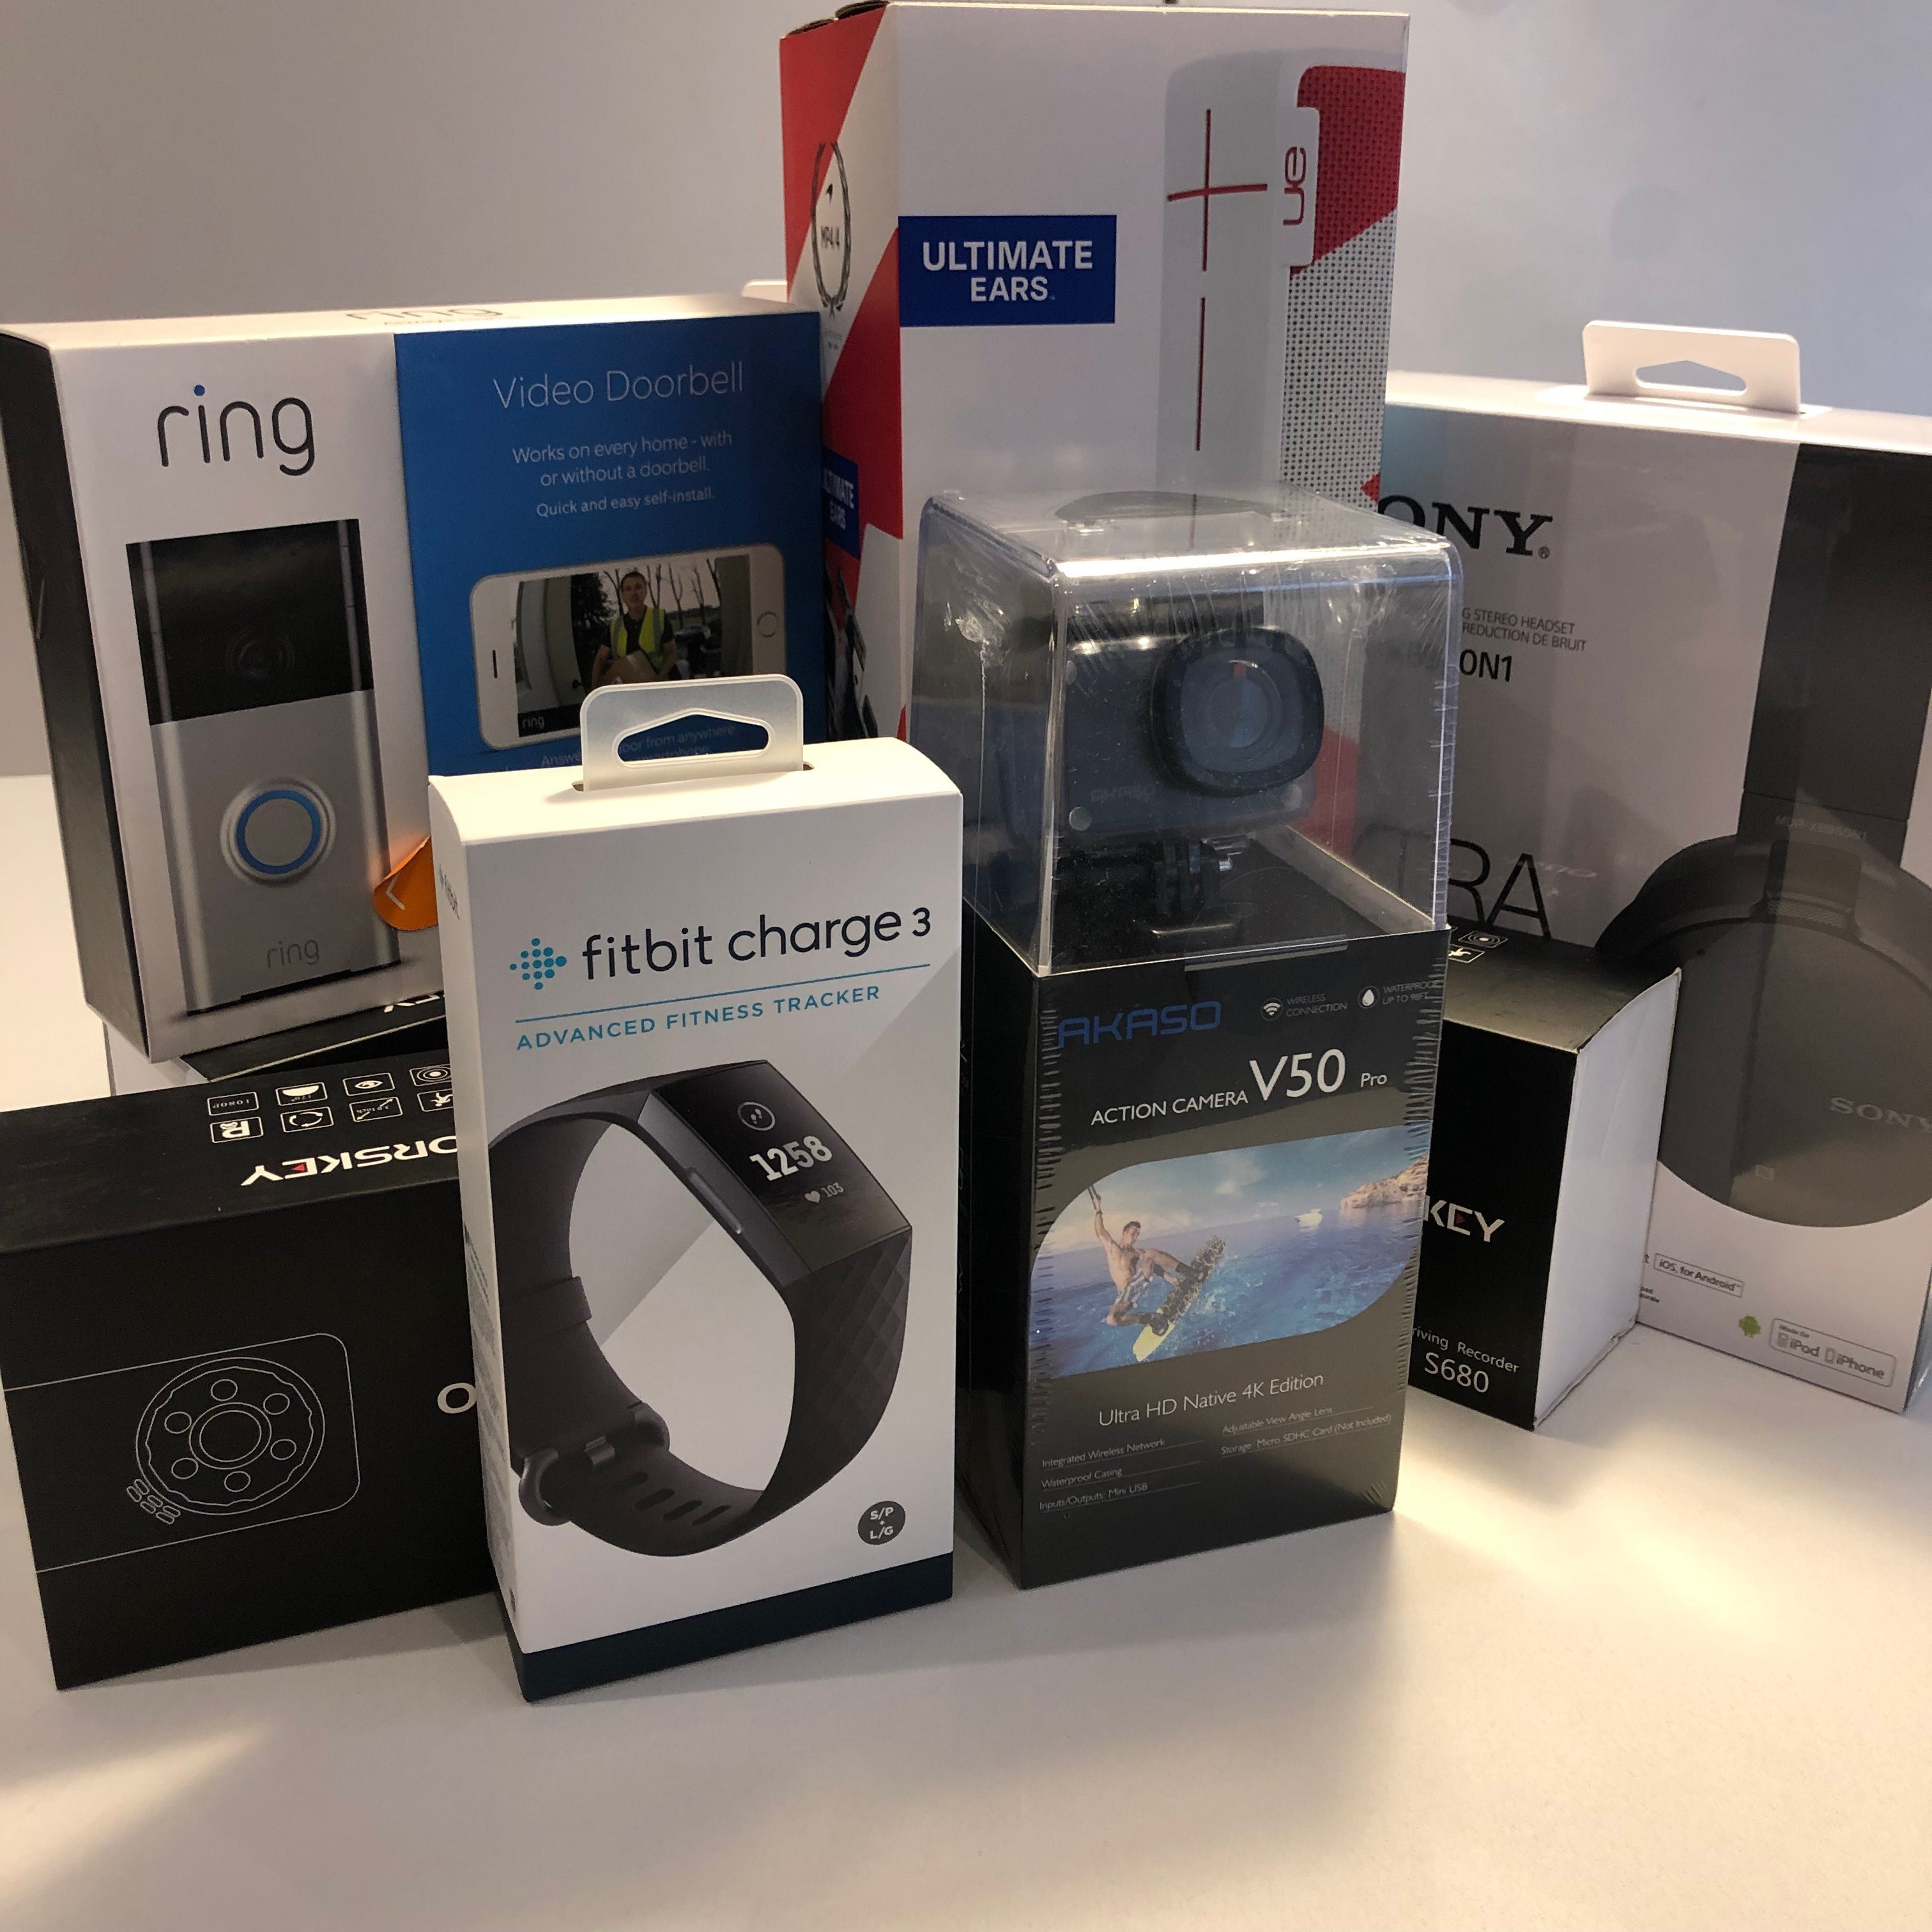
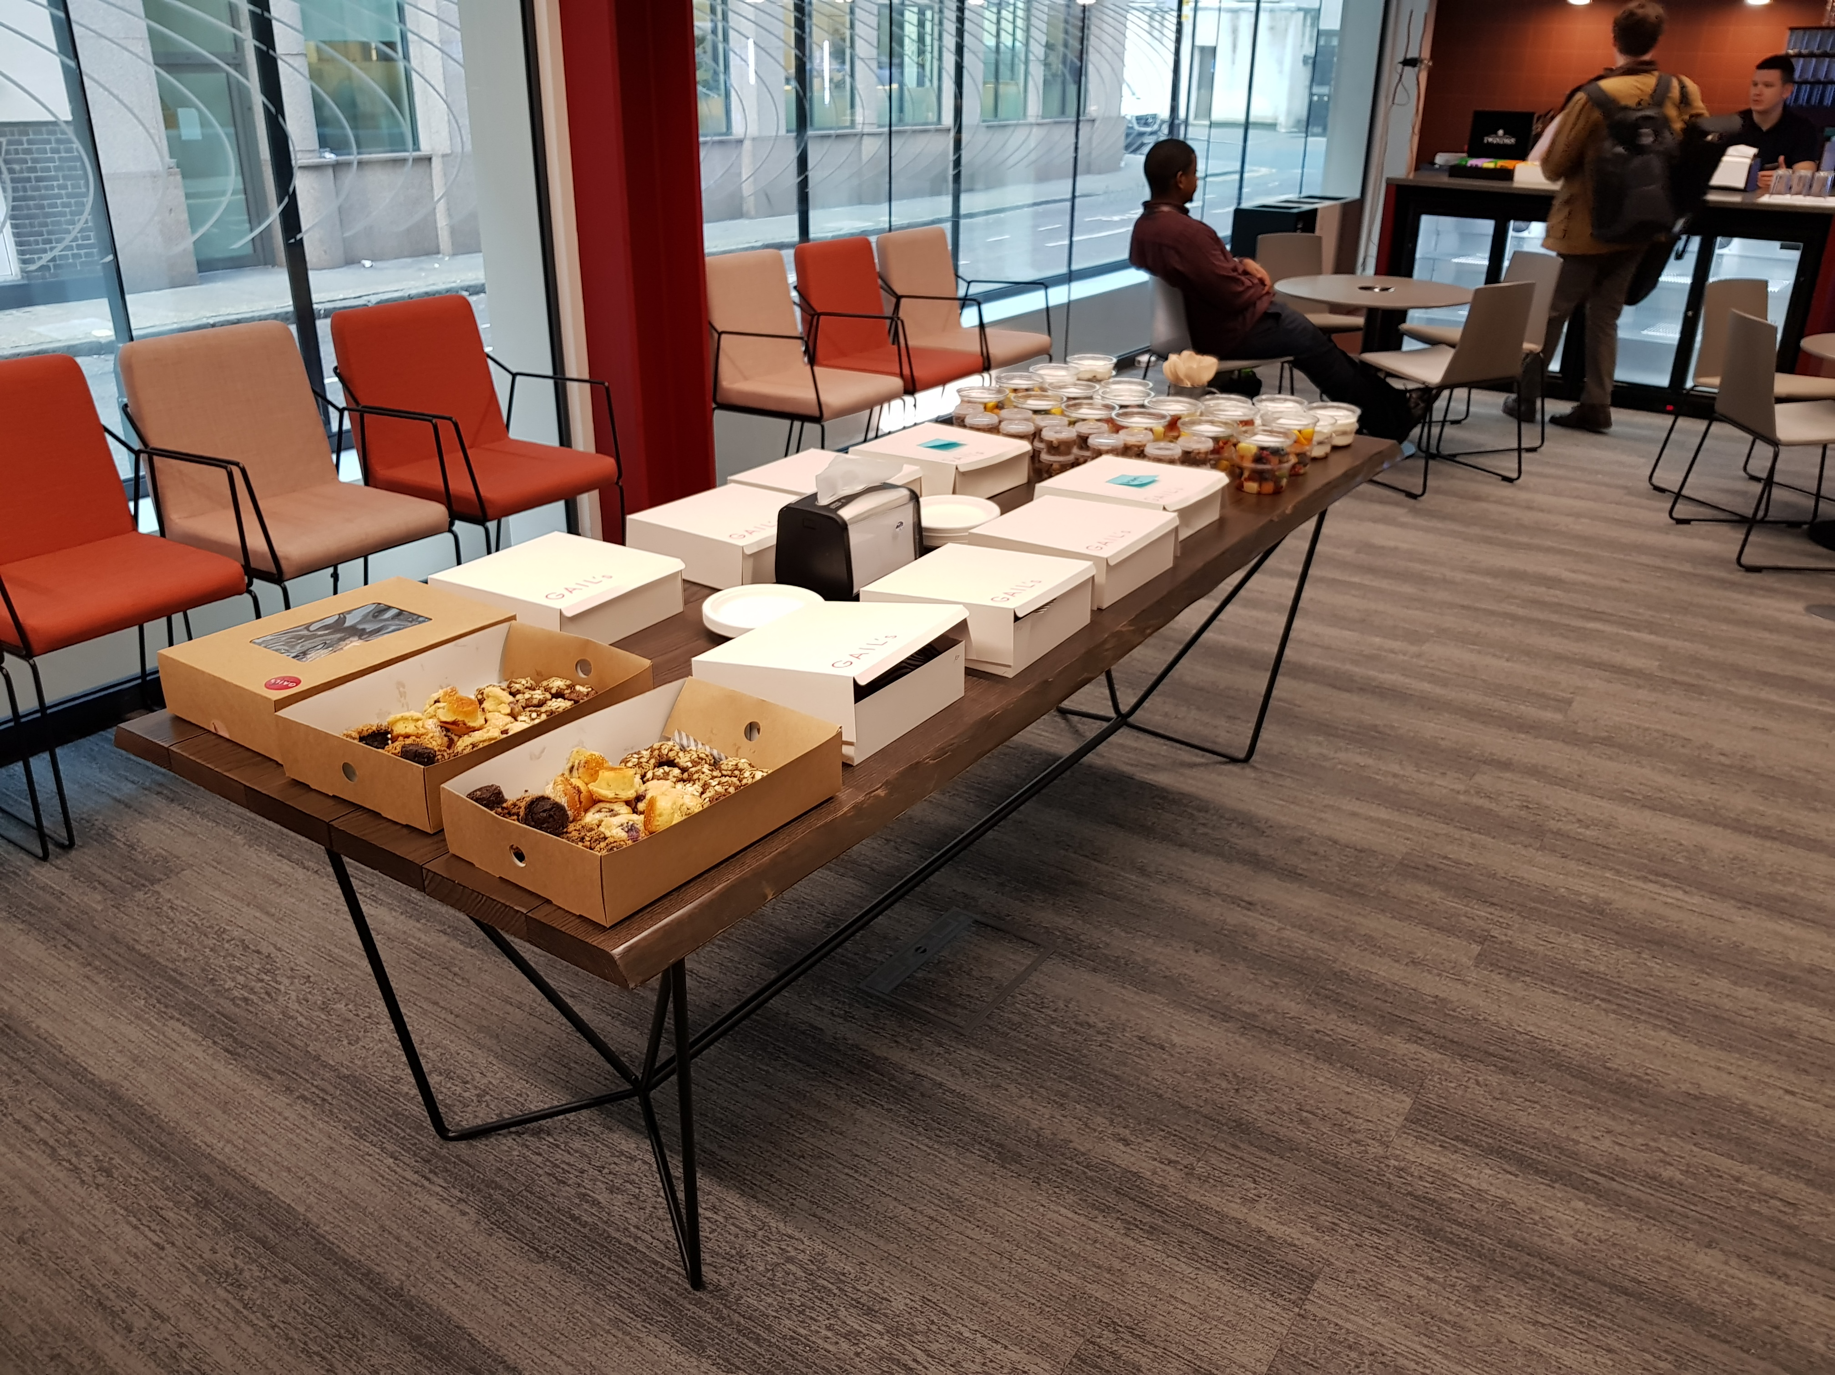
Walk through of the first/second day
Breakfast.
Summary of the challenges from industry specialists with knowledge of the particular sector.
Time to think about what you’d like to do.
An opportunity to deliver a 60 second pitch to everyone, if you want to.
Teams will then form. Either around the challenges or your vision that you have pitched. Max 6 people per team.
Hack, hack, hack.
We’ll then have 2 panels of judges. Your team will deliver a 5 min pitch to one of the panels after lunch on Sunday.
The winning team from each panel will go to a head judging panel. You’ll have a 7 min pitch. The judges will then deliberate.
Prizes will then be awarded on a team and personal basis.

Slide 9
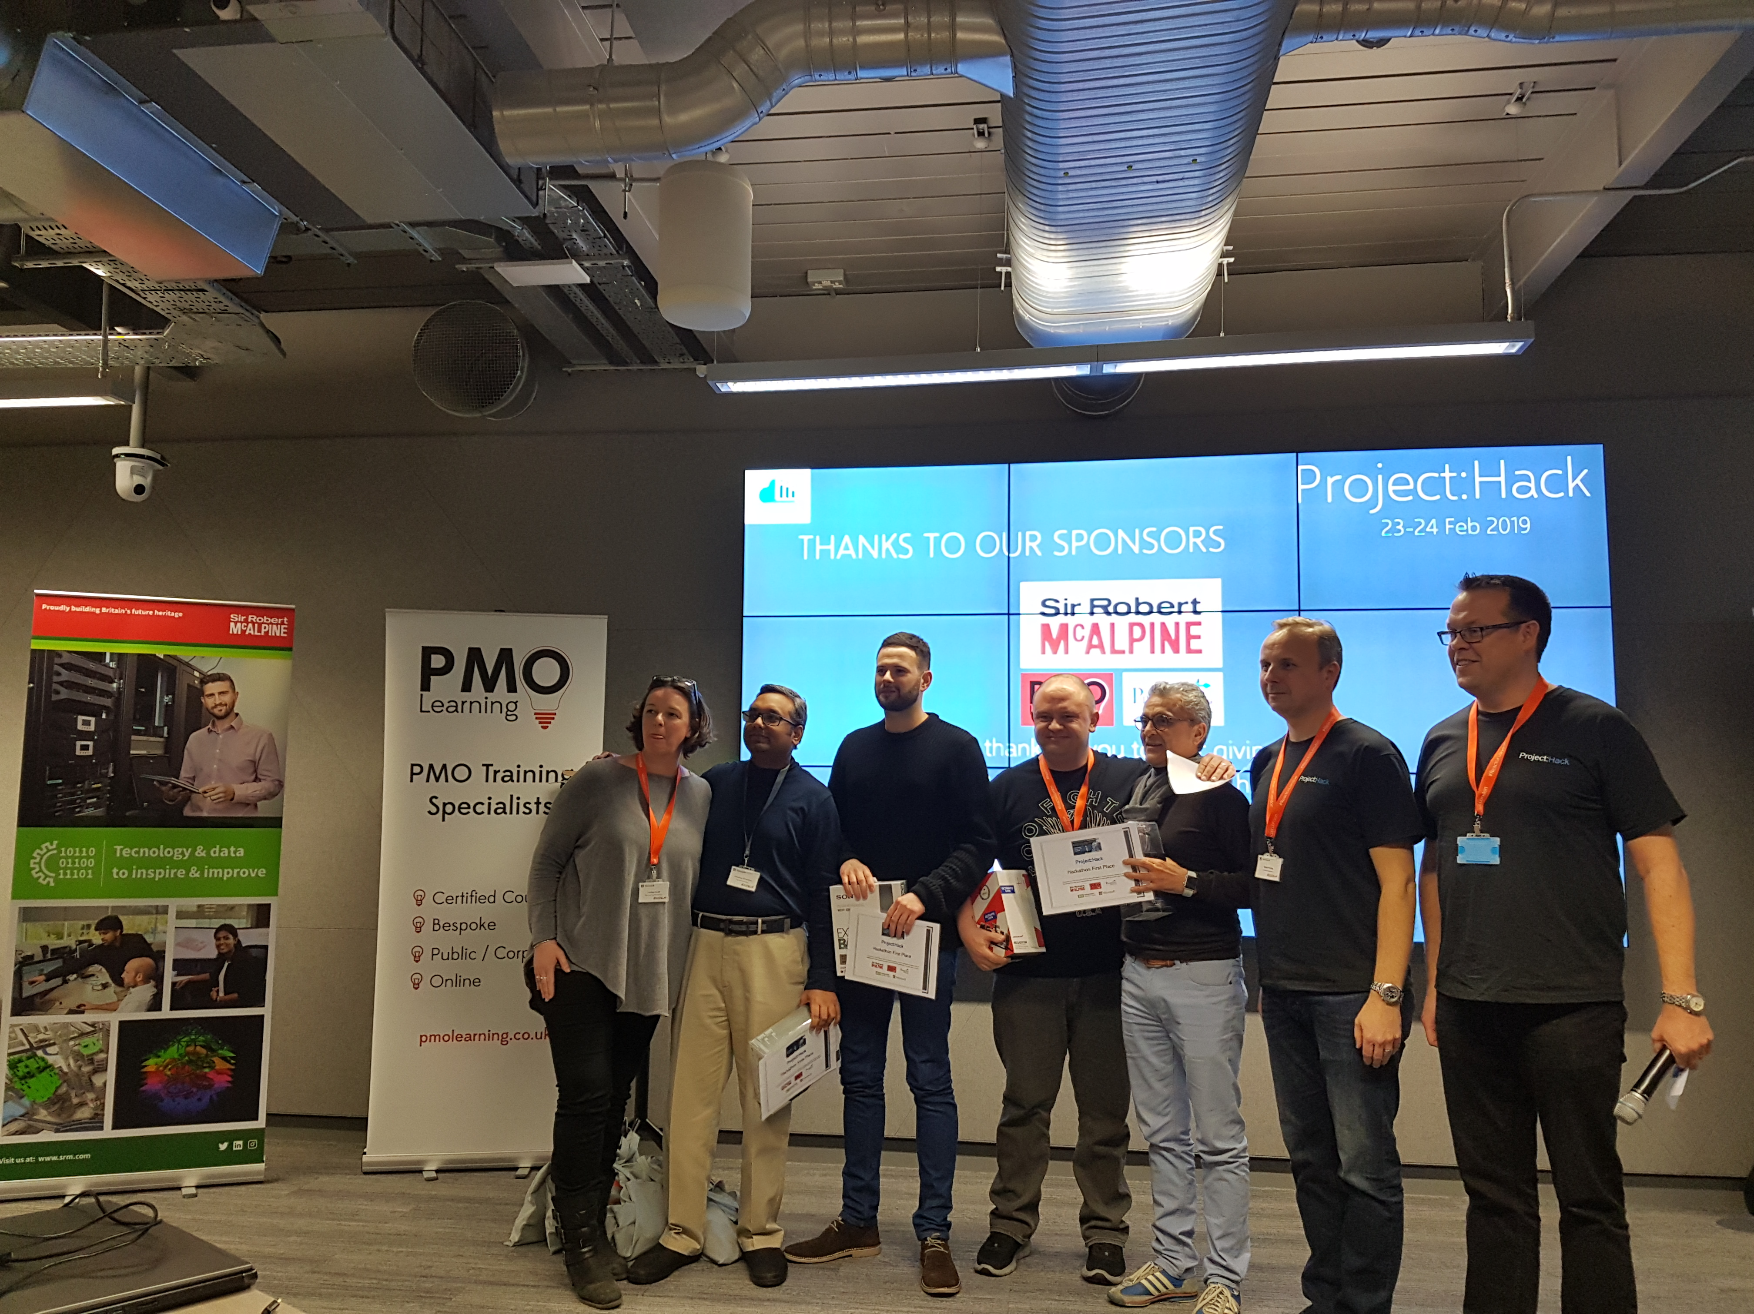
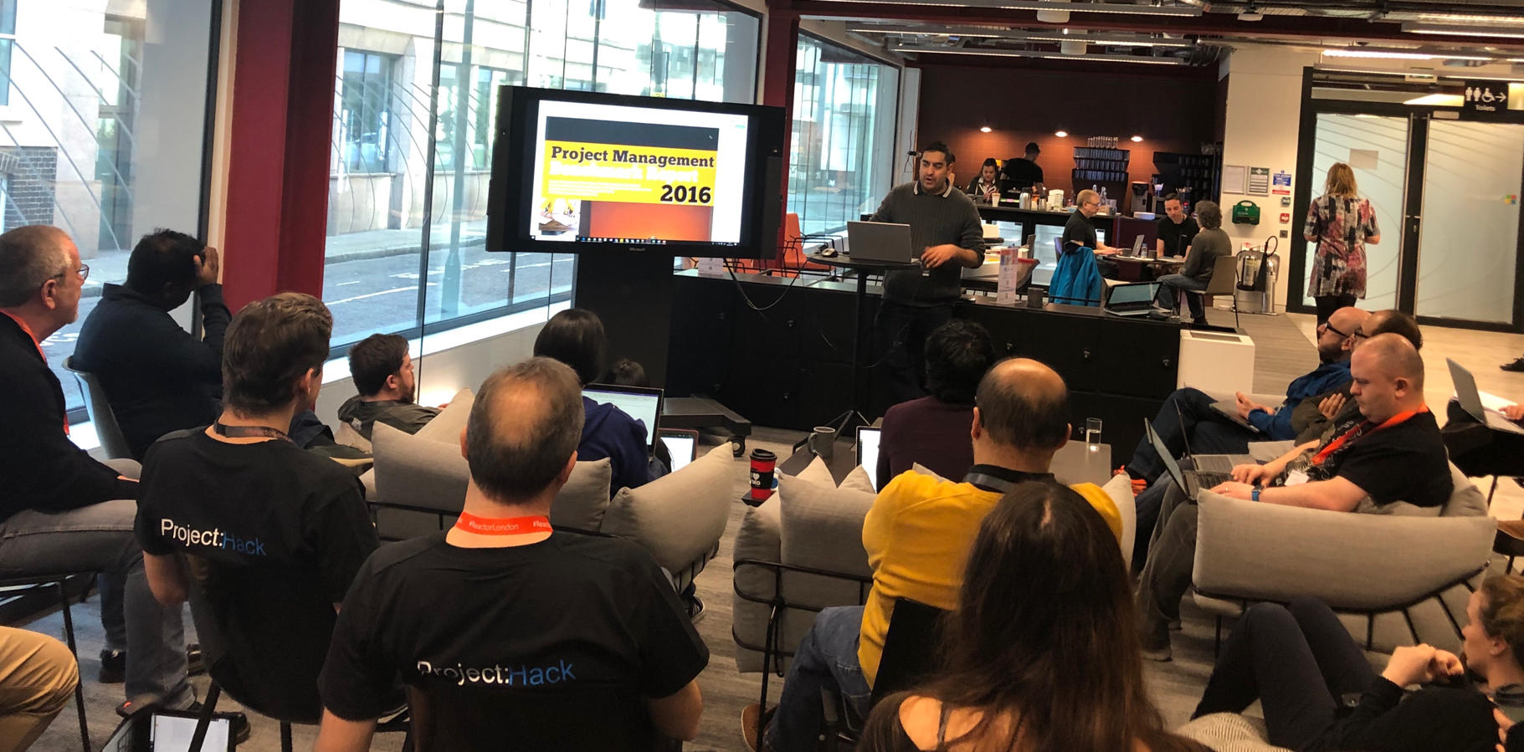
Some of the challenges…
CHALLENGE 1
Personal Risk Profiling
Problem Statement: 82,000 workers in construction suffer from work-related ill health
Solution: Create an app to predict the biggest risk an individual will be exposed to based on their situation & demographics (age, role, project type, etc.), in order to present them with that risk.
CHALLENGE 2
Residential Quality Management Dashboard
Problem Statement: Managing ‘snagging’ tasks is critical to ensuring we finish projects and deliver the quality product our clients require
Solution: Take the existing Power BI Quality Dashboard and tell us what else we can understand from this dataset. What happens if we combine ‘snagging’ insights with data for people on site?

Slide 10


How to tackle data analytics problems
Use cases
?
?
?

Slide 11

10:00 - What Problems are we Trying to Solve?
30 minutes
https://www.ogauthority.co.uk/lessons-learned/
User story: Example
As a project manager I want to understand what challenges are likely to arise in the next 12 months, including how likely they are and their potential impact so that I can take action to manage or mitigate.
5 user stories: in groups of, say 3?
Consider the full range of roles
User stories
As a …… I want to….. so that I can…..

Slide 12


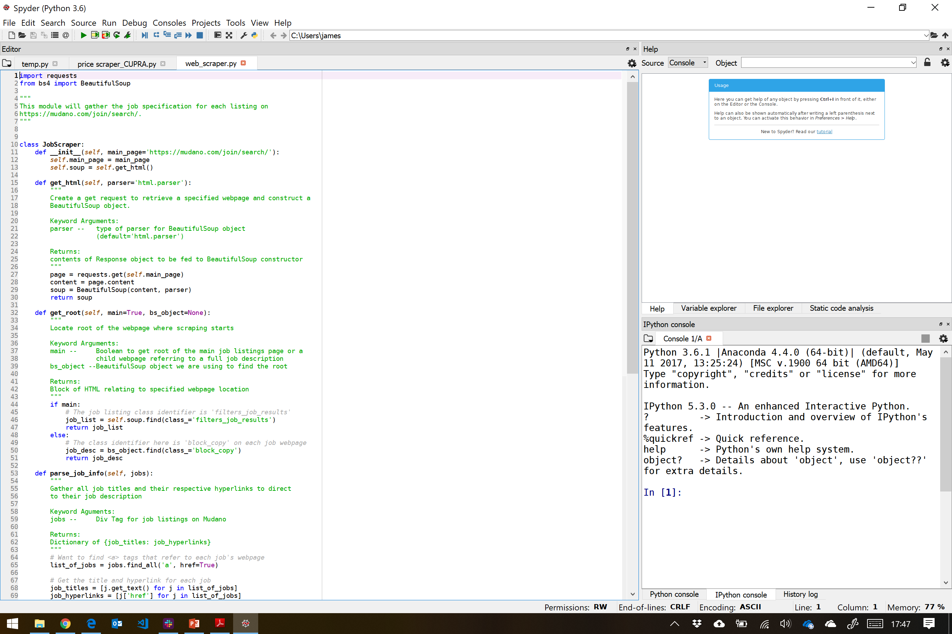

10:30 - Python Masterclass – An intro to web scraping
30 minutes
Intro to Google Colab
https://www.ogauthority.co.uk/lessons-learned/
Google Colab
GitHub_1
GitHub_2

Slide 13
11:00 – Challenge 1
60 minutes
Solve user stories from the exercise above (Conceptually if necessary)
Groups of, say 3?

Slide 14

12:00 – Team presentations
30 minutes
Template PowerPoint presentation
Upload when finished to Dropbox

Slide 15

12:30 – Lunch
60 minutes

Slide 16
13:30 – Challenge 2
30 minutes
Using ICT data can we predict how much a project is likely to slip (cost or schedule)?
Groups of, say 3?
ICT_data

Slide 17

14:00 - Python masterclass/exercise
30 minutes
Intro to Google Colab
Google Colab
Right click “copy link”
GitHub
GitHub – Jupyter Notebook
IRIS_data

Slide 18
14:30 – Group work
60 minutes
Using ICT data can we predict how much a project is likely to slip?
Groups of, say 3?
ICT_data

Slide 19
15:30 – Team presentations
30 minutes
Template PowerPoint presentation
Upload when finished to Dropbox

Slide 20
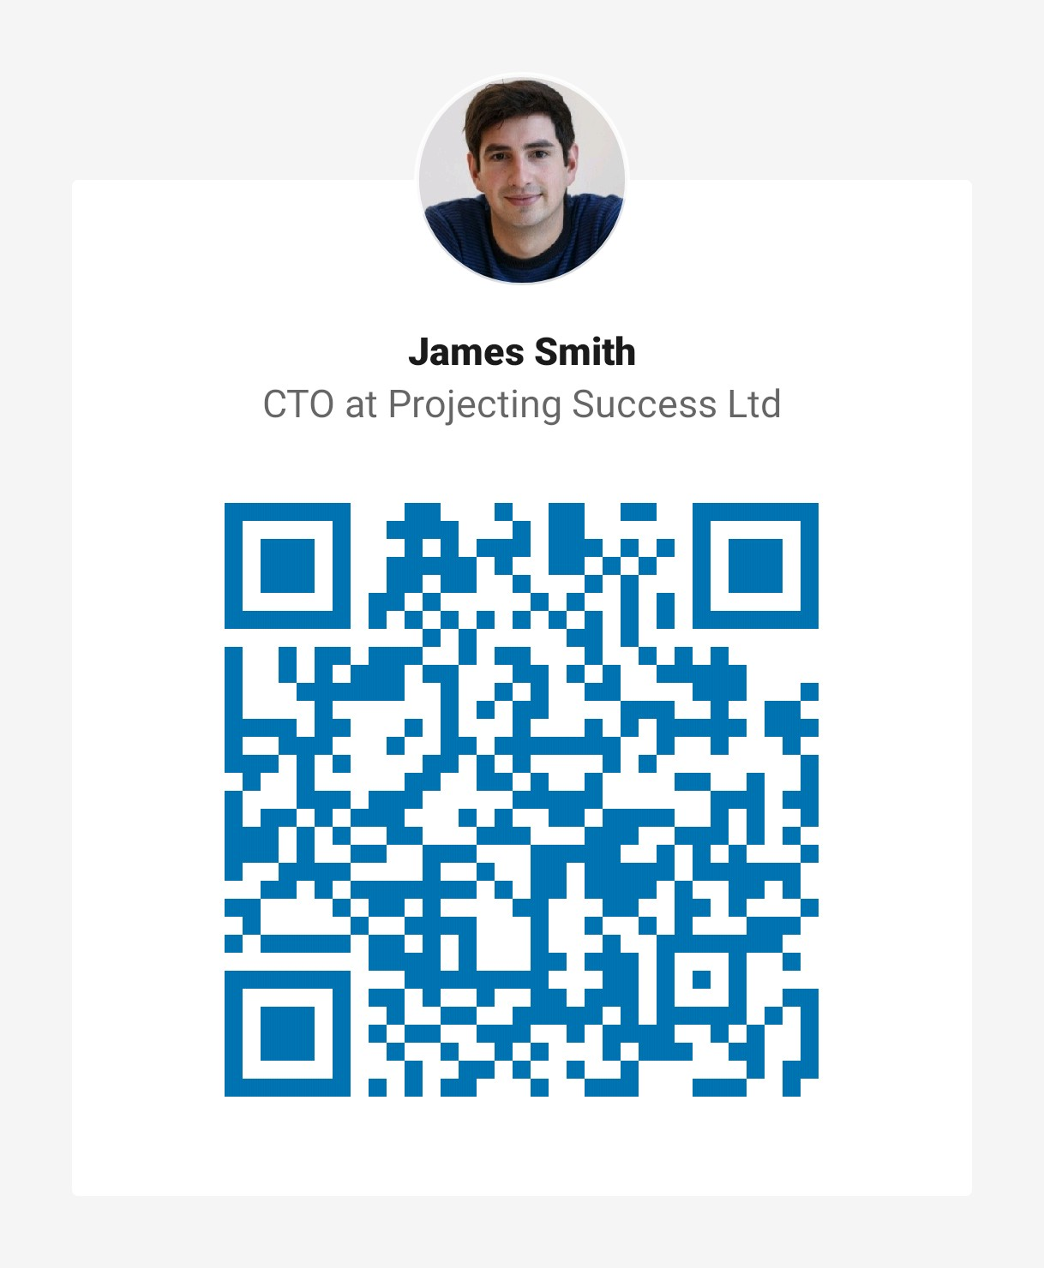
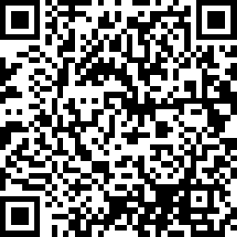
16:00 – Finish/Feedback
Thanks for listening
https://www.surveymonkey.co.uk/r/8LP2WR3

